Slide 1

Artificial Intelligence Programming Practice
Lecturer ： Rao Yunbo
University of Electronic Science and Technology of China ·
School of Information and Software Engineering
University of Electronic Science and Technology of China,
Chengdu, China , April 1, 2024

Slide 2
Chapter 7 Natural Language Processing

Slide 3
UESTC Natural Language Processing
01
NLP summary
02
NLP application
content
03
NLP Tasks
03
Word2Vec & GloVe model
Notes:
我们从这3个方面进行分析。

Slide 4
01
NLP Summary
Notes:
概述

Slide 5

What is natural language processing?
What is the main principle?

Slide 6
Natural Language Processing
What is natural language processing?
Natural Language Processing (NLP) is an important branch in the field of artificial intelligence, dedicated to enabling computers to understand, interpret, and produce human language. The purpose of natural language processing is to narrow the gap between human language and computers, enabling computers to perform the following tasks:
Speech recognition: Converting human speech into text.
Natural language understanding: Understanding the intention, emotions, and context of natural language.
Machine translation: Translating one language into another.
Text mining and text analysis: Extracting useful information and insights from text data.
Language generation: Generate natural language responses or text.
Dialogue system: Create systems that can communicate with humans, such as chatbots and virtual assistants.
Notes:
自然语言处理（Natural Language Processing，简称NLP）是人工智能领域中的一个重要分支，它致力于使计算机能够理解、解释和产生人类语言。自然语言处理的目的是缩小人类语言和计算机之间的差距，使计算机能够执行如下任务：
语音识别：将人类的语音转换成文本。
自然语言理解：理解自然语言的意图、情感和语境。
机器翻译：将一种语言翻译成另一种语言。
文本挖掘和文本分析：从文本数据中提取有用信息和洞察。
语言生成：生成自然语言响应或文本。
对话系统：创建能够与人类进行交流的系统，如聊天机器人和虚拟助手。

Slide 7
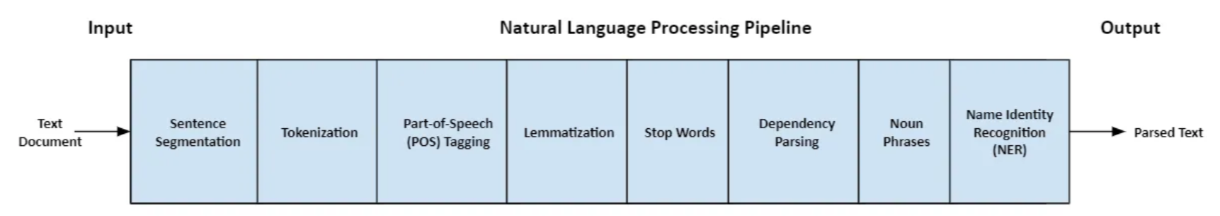
Natural Language Processing
A typical NLP process is as follows:
Notes:
一个典型的NLP流程如下所示：

Slide 8
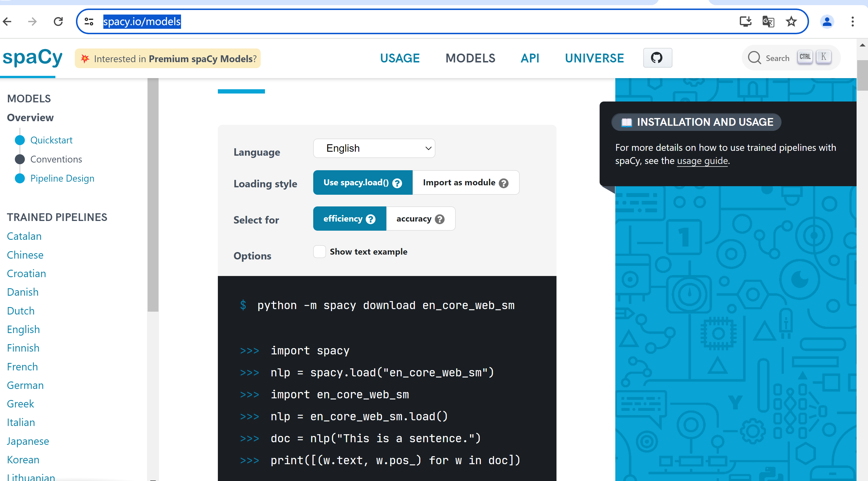
Exercise 1: Using spaCy for tokenization
https://spacy.io/models

Slide 9
Exercise 1: Using spaCy for tokenization
Input：
# input[0]: import spacy nlp=spacy.load('en_core_web_sm') text="Mary, don't slap the green witch" print([str(token)for token in nlp(text.lower())])
https://spacy.io/models
output：？
(base) PS D:\pythonpa> python -m spacy download en_core_web_sm

Slide 10
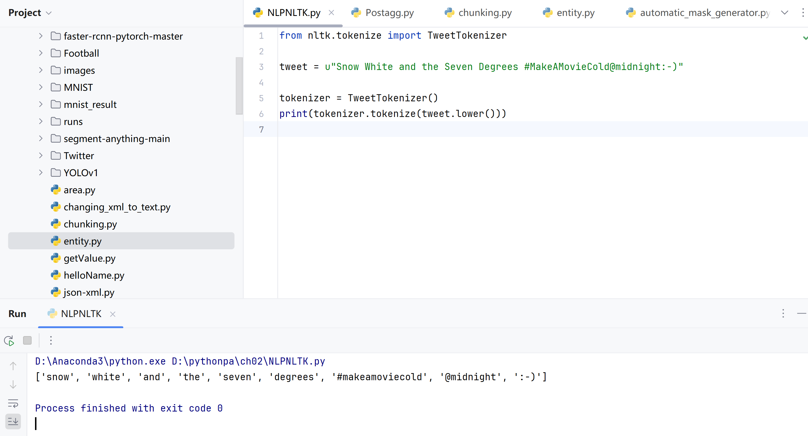
Exercise 2: Using NLTK for tokenization
Notes:
练习2：使用NLTK进行tokenization

Slide 11
Natural Language Processing
The process of text normalization in NLP
Combining All Content - Building a Text Normalizer:
Remove special characters (punctuation, accent, and other diacritical marks)
Remove Spaces
Word tokenization
Stemming and Lemmatization
Delete stop words, sparse terms, and specific words
Convert text (all letters) to lowercase
Delete HTML tags
Expand Abbreviations
Convert numbers to words or delete numbers
Notes:
将所有内容结合在一起-构建文本规范化器：
删除特殊字符（标点符号、重音符号和其他变音符号）
删除空格
单词分词（word tokenization）
词干和词形化 (Stemming and Lemmatization)
删除停止词、稀疏词和特定词 (stop words, sparse terms, and particular words)
将文本（所有字母）转换为小写形式
删除HTML标签
展开缩写形式
将数字转换为单词或删除数字

Slide 12
02
NLP Tasks
Notes:
常见的自然语言处理任务

Slide 13
Natural Language Processing Tasks
POS Tagging（词性标注）
Part of speech tagging (POS tagging), also known as grammatical tagging or word category disambiguation, is a text data processing technique in corpus linguistics that marks the part of speech of words in a corpus based on their meaning and context.
In traditional grammar, part of speech (POS) is a class of words with similar grammatical properties. Part of speech explains how a word is used in a sentence. There are eight parts of speech in English: nouns, pronouns, verbs, adjectives, adverbs, prepositions, conjunctions, and interjections.
Noun (N) — John, London, Table, Teacher, Pen, City, Happiness, Hope
Pronoun(PRO) — I, We, They, You, He, She, It, Me, Us, Them, Him, Her, This, That Verb (V) — Read, Eat, Go, Speak, Run, Play, Live, Have, Like, Are, Is
Notes:
词性标注（Part-Of-Speech tagging, POS tagging）也被称为语法标注（grammatical tagging）或词类消疑（word-category disambiguation），是语料库语言学（corpus linguistics）中将语料库内单词的词性按其含义和上下文内容进行标记的文本数据处理技术。
在传统语法中，词性（POS）是具有相似语法属性的一类词。词性解释了一个词在句子中是如何使用的。英语中有八个词类：名词、代词、动词、形容词、副词、介词、连词和感叹词。

Slide 14
Natural Language Processing Tasks
The process of classifying words into their parts of speech and labeling them accordingly is called part of speech tagging. Part of speech is also known as part of speech or vocabulary category. The set of tags used for a specific task is called a tag set.
Noun (N) — John, London, Table, Teacher, Pen, City, Happiness, Hope
Pronoun(PRO) — I, We, They, You, He, She, It, Me, Us, Them, Him, Her, This, That Verb (V) — Read, Eat, Go, Speak, Run, Play, Live, Have, Like, Are, Is
Adverb(ADV) — Slowly, Quietly, Very, Always, Never, Too, Well, Tomorrow Adjective(ADJ) — Big, Happy, Green, Young, Fun, Crazy, Three Preposition (P) — At, On, In, From, With, Near, Between, About, Under
Conjunction (CON) — And, Or,But, Because, So, Yet, Unless, Since, If
Interjection (INT) — Ouch! Wow! Great! Help! Oh! Hey! Hi!
Notes:
将单词分类到它们的词性并相应地标记它们的过程被称为词性标记。词性也被称为词类或词汇类别。用于特定任务的标记集合称为标记集。

Slide 15
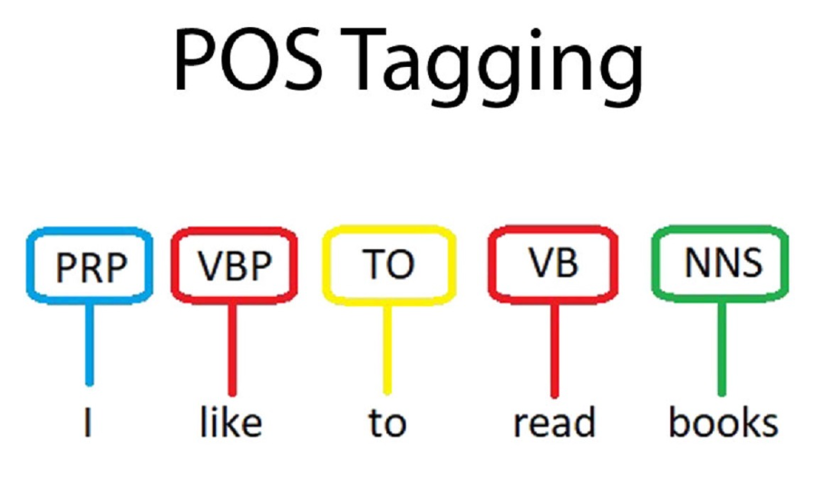
Natural Language Processing Task
POS Tagging（词性标注）
There are many tools that include POS markers, including NLTK, TextBlob, spaCy, Pattern, Stanford University CoreNLP, Memory Based Shallow Parser (MBSP), Apache OpenNLP, Apache Lucene, General Text Engineering Architecture (GATE), FreeLing, Illinois Part of Speech Tagger, and DKPro Core.
Notes:
有许多工具包含POS标记器，包括NLTK，TextBlob，spaCy，Pattern，斯坦福大学CoreNLP，基于内存的浅层解析器（MBSP），Apache OpenNLP，Apache Lucene，通用文本工程架构（GATE），FreeLing，Illinois Part of Speech Tagger和DKPro Core。

Slide 16
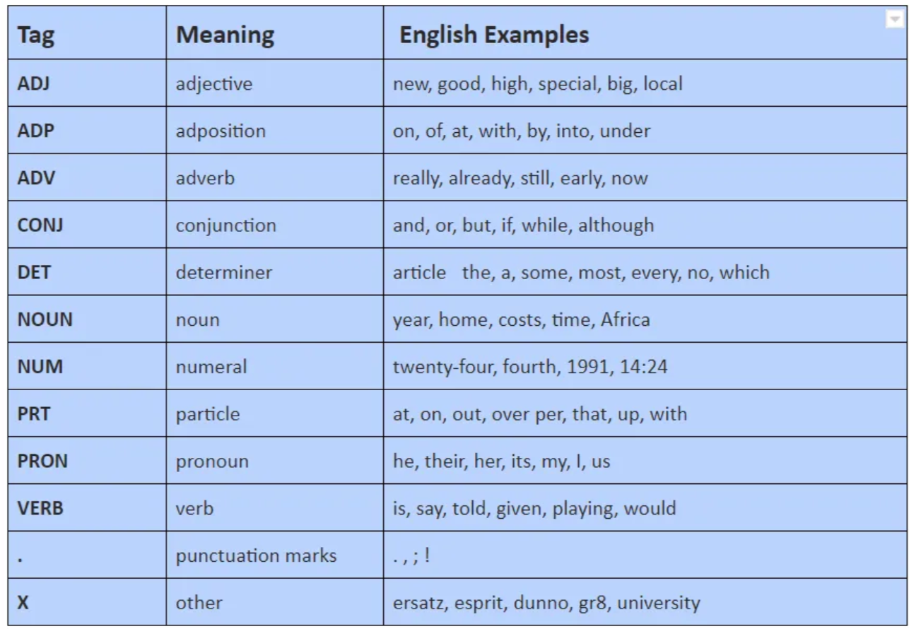
Natural Language Processing Task
POS Tagging（词性标注）
The universal label set of NLTK includes 12 label categories: verbs, nouns, pronouns, adjectives, conjunctions, adjectives, conjunctions, qualifiers, cardinals, particles, other/loanwords, punctuation marks. This dataset has 3914 marked sentences and 12408 vocabulary words.
Notes:
NLTK的通用标签集包括12个标签类：动词、名词、代词、形容词、连词、形容词、连词、限定词、基数词、助词、其他/外来词、标点符号。这个数据集有3，914个标记的句子和12，408个单词的词汇。

Slide 17
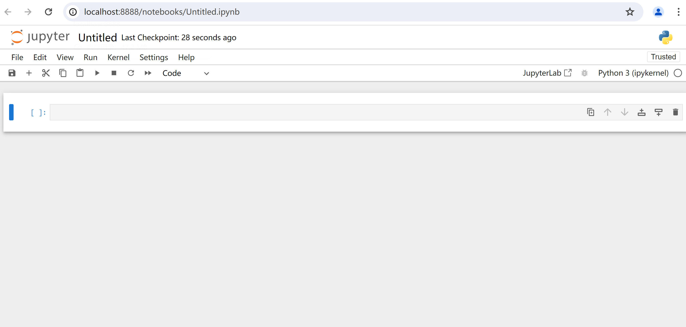
Natural Language Processing Task
POS Tagging（词性标注）
How to create new Jupyter file

Slide 18
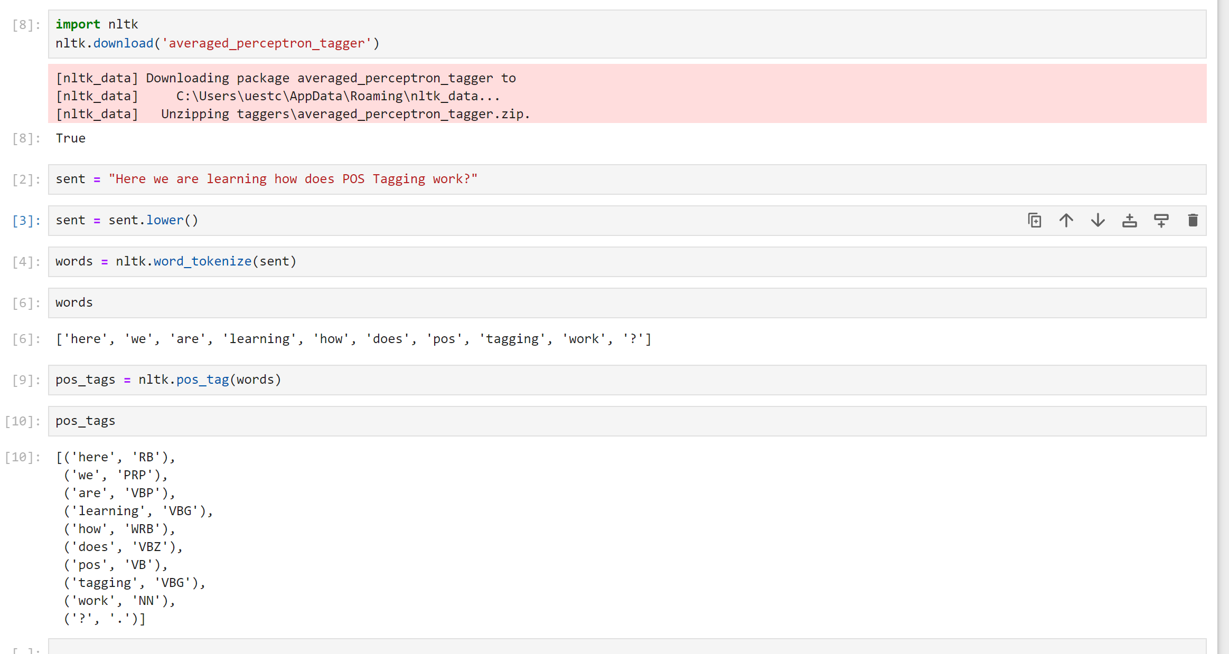
Natural Language Processing Task
POS Tagging（词性标注）
Example: Using NLTK for POS tagging

Slide 19
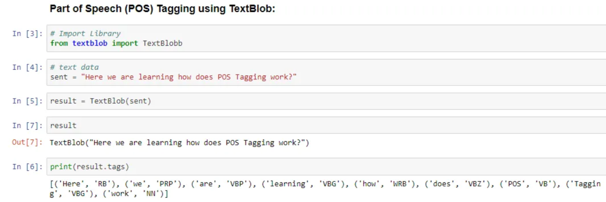
Natural Language Processing Task
POS Tagging（词性标注）
Example： using TextBlob for POS tagging

Slide 20
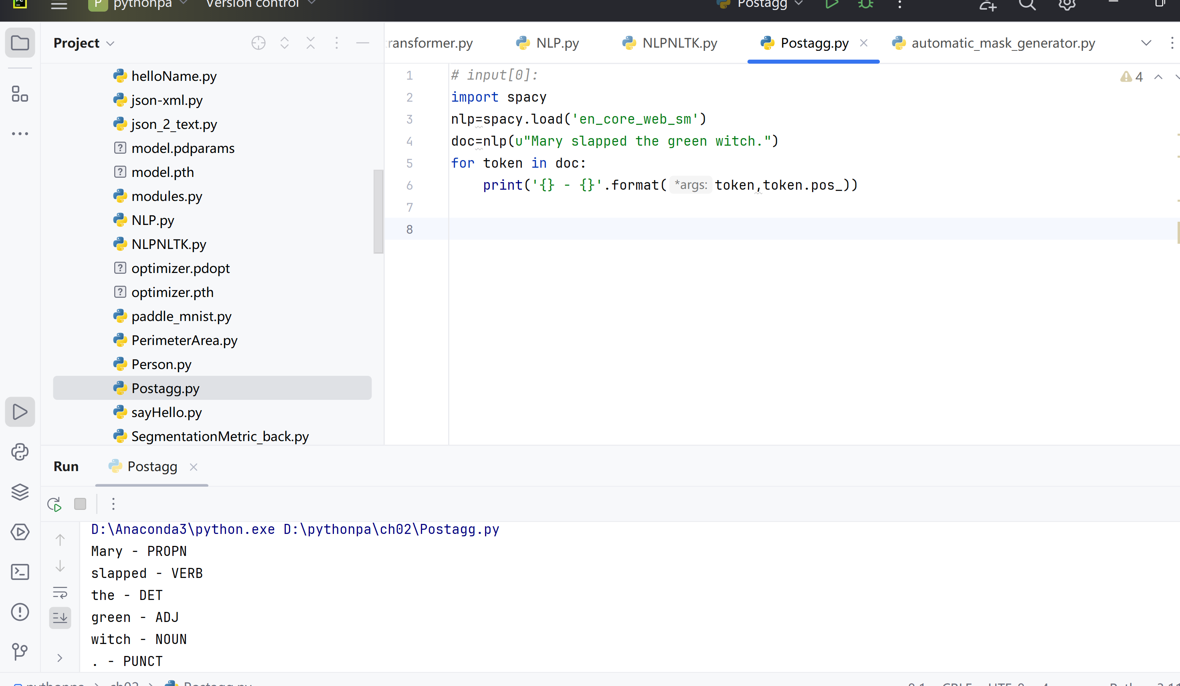
Using spacy
Natural Language Processing Task
Notes:
xuw

Slide 21
Natural Language Processing Task
Chunking (分块)
To analyze the structure of a sentence, we need to identify noun phrases (NP) and verb phrases (VP), which are called chunking. As shown below:
[NP Mary] [VP slapped] [NP the green witch].
Notes:
为了解析句子的结构，我们需要识别其中的名词短语（noun phrase，NP）和动词短语（verbal phrase, VP），这被称作分块（Chunking）。如下面所示：

Slide 22
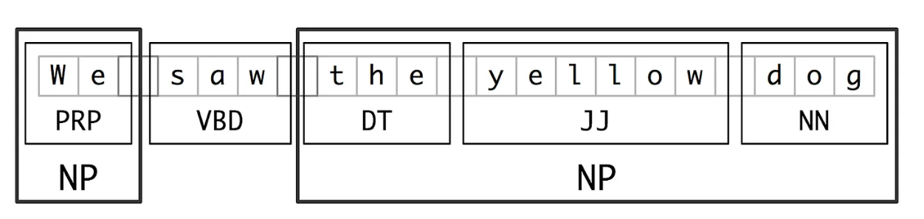
Natural Language Processing Task
Chunking (分块)
The purpose of Chunking is to derive higher-order units composed of grammatical atoms such as nouns, verbs, adjectives, etc. Regular expressions can be written on part of speech markers to approximate chunking. For English and other widely used languages, there exists data and pre trained models.
Notes:
Chunking的目的是推导出由名词、动词、形容词等语法原子组成的高阶单位，可以在词性标记上编写正则表达式来近似实现分块。对于英语及其它广泛使用的语言来说，存在着数据和预先训练好的模型。

Slide 23
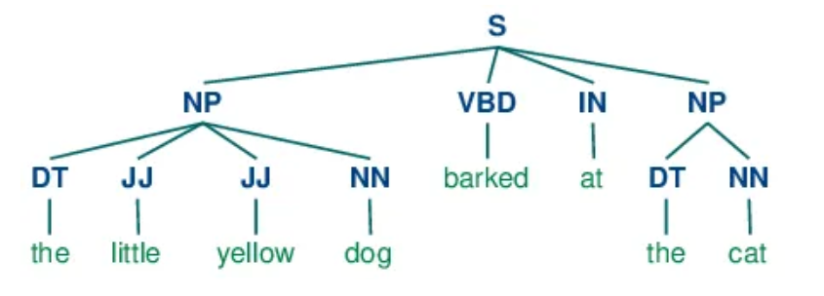
Natural Language Processing Task
Chunking (分块)
Chunking Tools include：NLTK，TreeTagger chunker，Apache OpenNLP，General Architecture for Text Engineering（GATE），FreeLing。
In addition, Space or TextBlob can output ready-made phrases.
A set of standard Chunk tags is as follows:
Noun Phrase(NP) 名词短语（NP）
Verb Phrase (VP) 动词短语（VP）
Notes:
此外，Spacy或TextBlob可以输出现成的短语。
一组标准的Chunk标签如下：

Slide 24
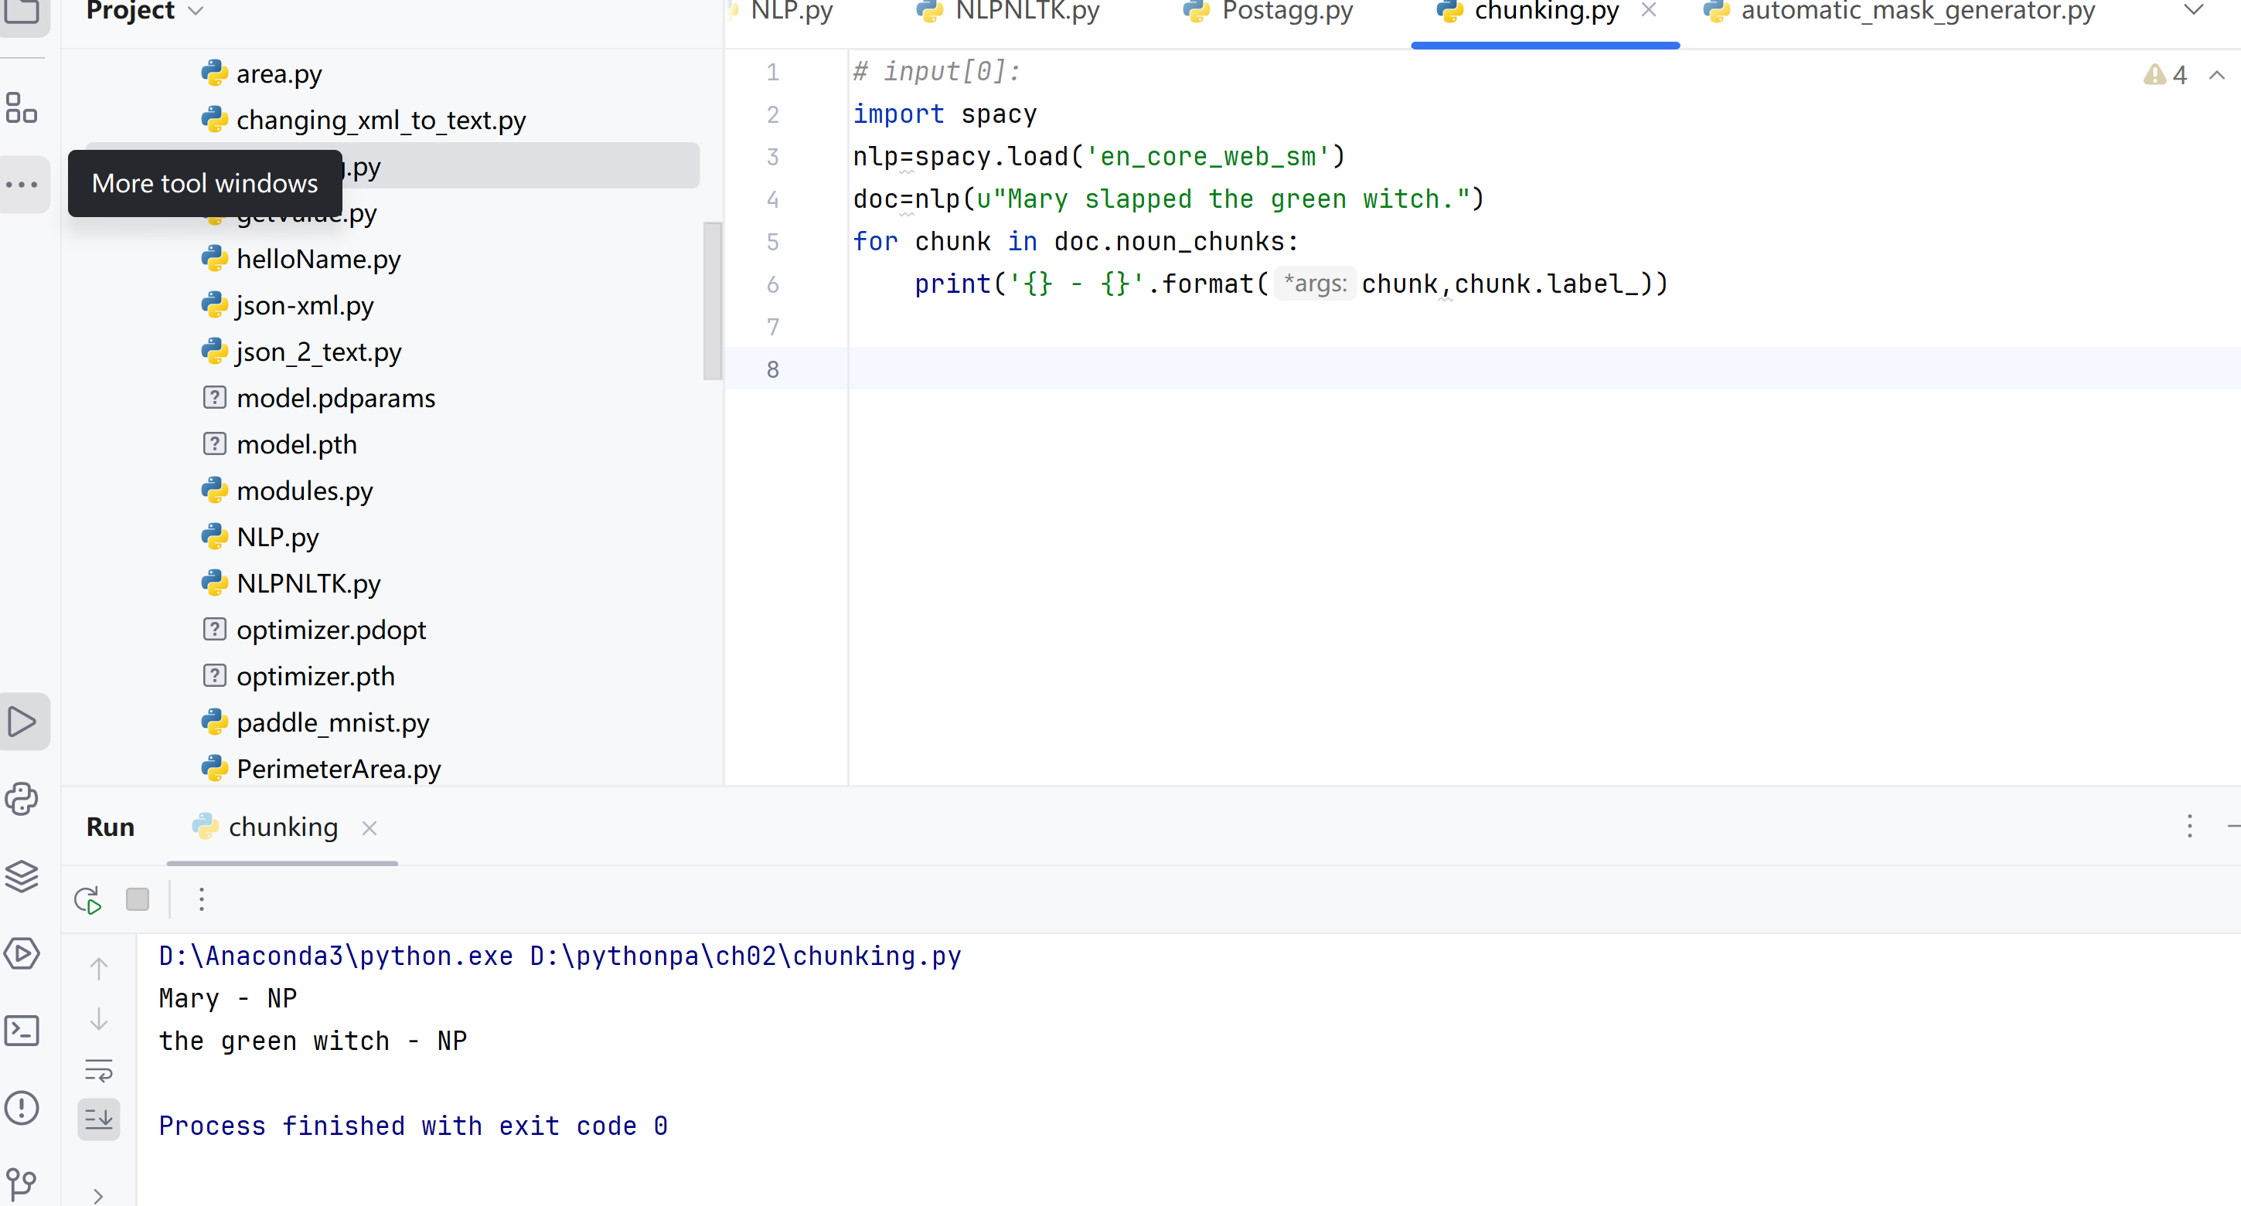
Example：Chunking

Slide 25
Natural Language Processing Task
命名实体识别(Named Entity Recognition)
Named Entity Recognition (NER) is usually the first step in information extraction, attempting to identify and classify named entities in text, such as name, location, object, organization, time of people in predefined categories, price, monetary value, percentage, product, etc.
The commonly used named entity types are:
ORGANIZATION: Georgia-Pacific Corp., WHO
PERSON: Eddy Bonte, President Obama
LOCATION: Murray River, Mount Everest
DATE: June, 2008–06–29
TIME: two fifty a m, 1:30 p.m.
MONEY: 175 million Canadian Dollars, GBP 10.40
PERCENT: twenty pct, 18.75 %
FACILITY: Washington Monument, Stonehenge
GPE: South East Asia, Midlothian
Notes:
命名实体识别（NER）通常是信息提取的第一步，试图识别和分类文本中的命名实体，如名称，位置，事物，组织，预定义类别中的人的时间，价格、货币价值、百分比、产品等。

Slide 26
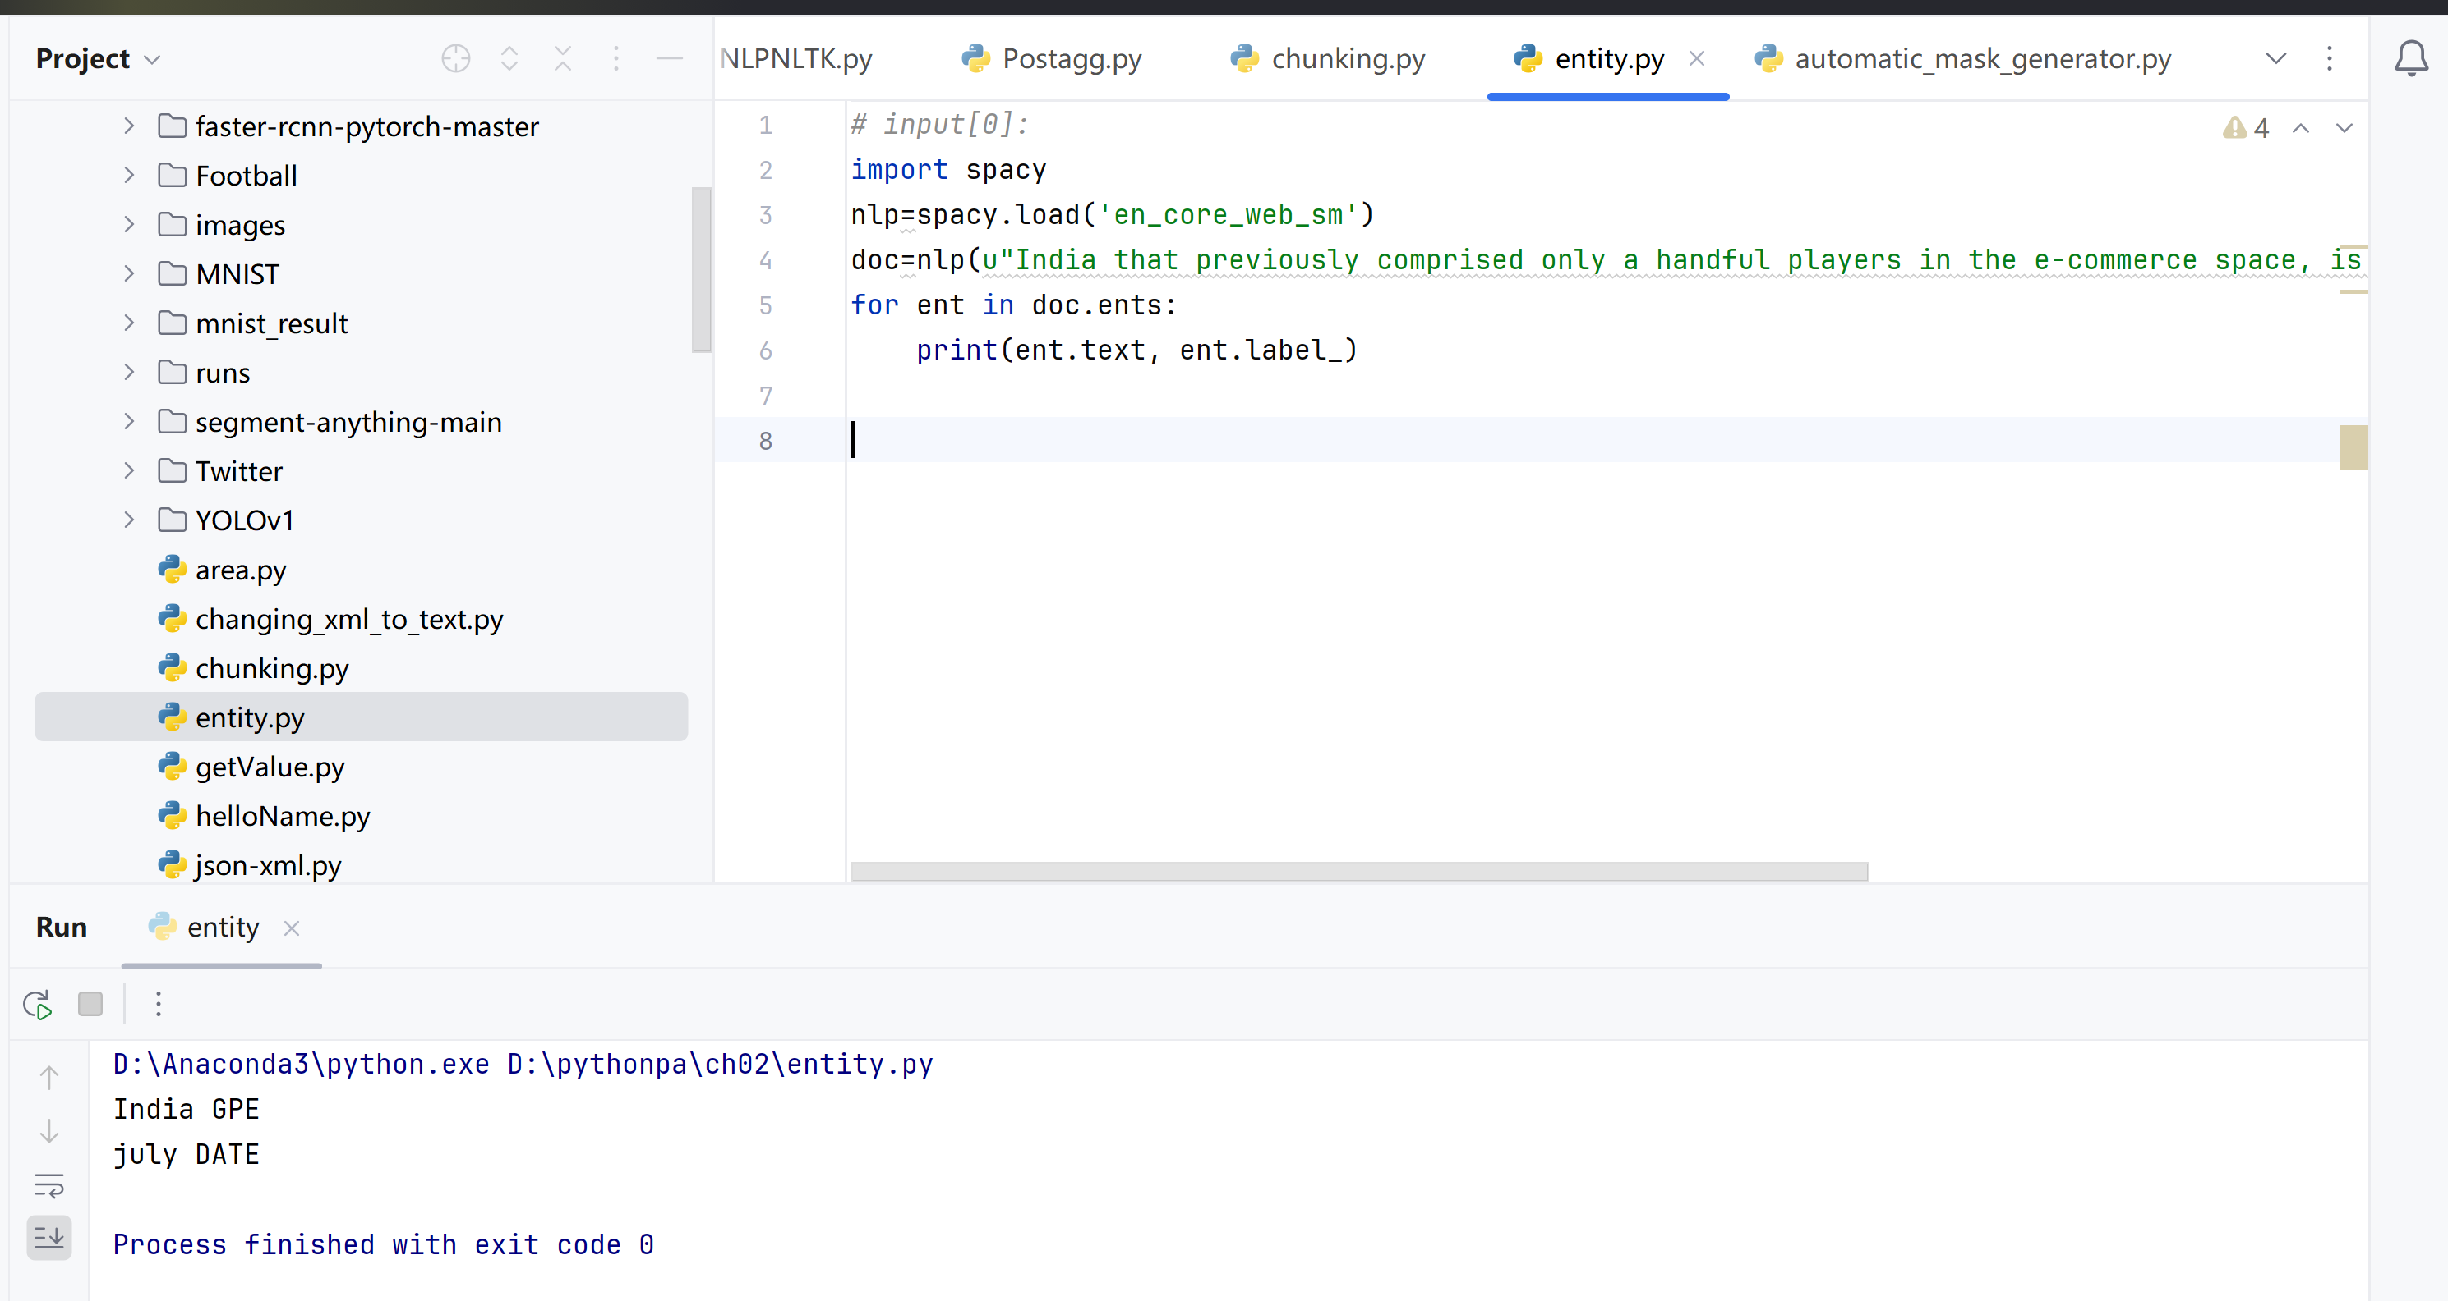
Example：using spaCy for Named Entity Recognition
doc=nlp(u"India that previously comprised only a handful players in the e-commerce space, is now home to many biggies and july.")

Slide 27
03
NLP Application

Slide 28
Application 1： twitter_Logistic
Task：
1. Understand code structure
2. Run twitter_Logistic.ipynb
Twitter情感分析（Logistic回归）
Content:
1-Data visualization
2-Text analysis
3-Text vectorization
4-Model building

Slide 29
Application2： bi_lstm function
Task：
Understand code structure
Run bi_lstm.ipynb
Content:
1-Load necessary libraries
2-Overview of Datasets
3-Exploratory Data Analysis,(EDA)
4-Text data cleaning
5-Common methods in NLP:
CounterVectorizer
TF-IDF
N-Grams
POS (Part Of Speech)
NER (Named Entity Recognition)
Stopwords
Lemmas and Stems
Tokenization
Display commonly used words and punctuation marks
Wordcloud visualization
6- Prepare dataset through Python and Keras libraries
7-Use bidirectional LSTM to classify text
Notes:
内容:
1-加载必要的库
2-数据集的概览
3-探索性数据分析(Exploratory Data Analysis,EDA)
4-文本数据清洗
5-NLP中的常见方法:
CounterVectorizer
TF-IDF
N-Grams
POS(Part Of Speech)
NER(Named Entity Recognition)
Stopwords
Lemmas and Stems
Tokenization
显示常用单词和标点符号
Wordcloud可视化
6-通过Pytorch和Keras库准备数据集
7-使用双向LSTM对文本进行分类

Slide 30
04
Word2Vec & GloVe model
Notes:
内容: 1-加载必要的库 2-数据集的概览 3-探索性数据分析(Exploratory Data Analysis,EDA) 4-文本数据清洗 5-NLP中的常见方法: CounterVectorizer TF-IDF N-Grams POS(Part Of Speech) NER(Named Entity Recognition) Stopwords Lemmas and Stems Tokenization 显示常用单词和标点符号 Wordcloud可视化 6-通过Pytorch和Keras库准备数据集 7-使用双向LSTM对文本进行分类

Slide 31
Learnable word embeddings
Word Embedding Method Based on Deep Learning
The Word Embedding method based on deep learning or neural networks mainly solves the high-dimensional problem generated by traditional natural language processing (NLP) word embedding methods.
The basic principle of this method is to train a neural network classifier to predict whether a word will co occur in the context of another word. The weight of this network can be understood as word embedding. Word2Vec and Glove are the two most common neural network-based word embedding methods.
Context information: Deep learning or neural network word embedding methods train neural networks to understand the meaning of words using context information. Traditional word embedding methods, such as One Hot Encoding, often lead to excessively high dimensions and are difficult to handle. The neural network method learns the semantic information of each word directly by predicting the co-occurrence relationship of words. At the same time, each word can be mapped to a smaller, dense vector space, solving the problem of dimensionality.
Notes:
可学习的词嵌入
基于深度学习的词嵌入（Word Embedding）方法
基于深度学习或神经网络的词嵌入（Word Embedding）方法主要解决的是传统自然语言处理（NLP）词嵌入方法产生的高维度问题。
这种方法的基本原理是：训练一个神经网络分类器来预测一个词是否会在另一个词的上下文中共同出现（co-occur）。这个网络的权重可以被理解为词嵌入。Word2Vec以及Glove便是两个最常见的基于神经网络结构的词嵌入方法。

Slide 32
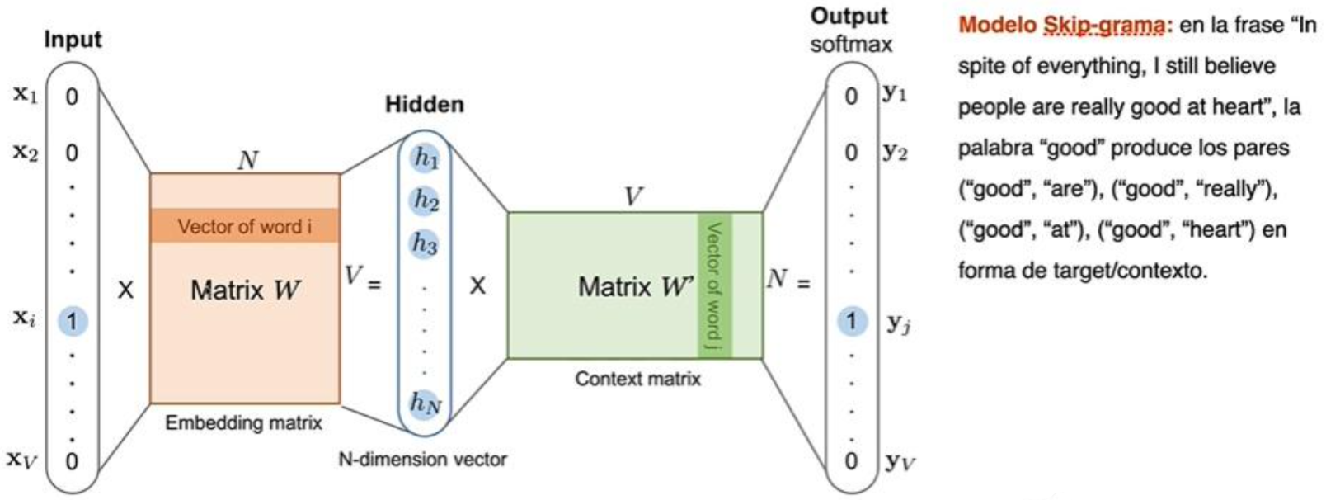
Word2Vec
Word2Vec principle: Word2Vec predicts word co-occurrence by training a neural network classifier.
This process involves training a neural network model with the goal of predicting which words may appear in the surrounding context of a given word. This is based on the assumption that the meaning and usage of words in language can be understood and captured through the context in which they appear.
Notes:
Word2Vec原理：Word2Vec通过训练神经网络分类器预测词的共现
这个过程涉及到训练一个神经网络模型，目标是预测给定一个词，在其周围上下文中哪些词可能出现。这基于的假设是，语言中词的意义和用法可以通过它们出现的上下文来理解和捕捉。

Slide 33
Word2Vec
Example: Consider the sentence: "The white polar bear is eating fish.". In this example, the model will learn how to predict "polar bear" based on "white", "fish eating" based on "polar bear", and so on, in order to capture contextual relationships between words.
Notes:
例子：考虑句子：“白色的北极熊在吃鱼”。在这个例子中，模型会学习如何根据“白色”预测“北极熊”，根据“北极熊”预测“吃鱼”，以此类推，从而捕捉单词之间的上下文关系。

Slide 34
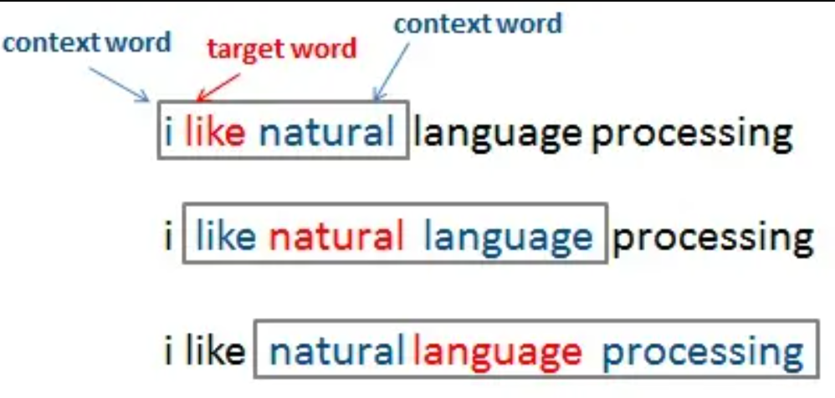
Word2Vec
Context window for Word2Vec
In the Word2Vec model, a context window is used to establish the content of the context for each word. A sliding window refers to capturing the relationship between words and their surrounding words by sliding a fixed size window within the text.
Notes:
Word2Vec的上下文窗口
在Word2Vec模型中，使用上下文窗口（Sliding Window）来建立对每个词的上下文的内容。上下文窗口（Sliding Window）指的是通过在文本中滑动一个固定大小的窗口来捕捉词与其周围词的关系。

Slide 35
Word2Vec
Word2Vec Sliding Window
Window size: The size of the contextual window defines the contextual range that should be considered when analyzing specific words. For example, if the window size is 2, for the sentence "White polar bear eating fish", the model will consider "White polar bear" and "Polar bear eating" as the context of "in".
Context capture: Using this method, the model can understand the relationship between "polar bear" and "white" and "eating fish" in "white polar bear". This helps to reveal the semantics of the word "polar bear" and construct its word vector based on its local context.
After training, the Word2Vec model can use a single word as input to predict the surrounding words, and the model learns the semantic relationships of the vocabulary.
Notes:
窗口大小：上下文窗口的大小定义了分析特定词时应考虑的上下文范围。例如，如果窗口大小为2，针对句子“白色的北极熊在吃鱼”，模型会考虑“白色的北极熊”和“北极熊在吃”作为“在”的上下文。
上下文捕捉：使用这种方法，模型能够理解“白色的北极熊”中“北极熊”与“白色的”和“在吃鱼”之间的关系。这有助于揭示“北极熊”一词的语义，基于其局部上下文构建其词向量。
在训练完成之后，Word2Vec模型便可以使用单个词作为输入，来预测它周围的词，模型也就学会了词汇的语义关系。

Slide 36
Word2Vec
Word2Vec train detailed
Both the input and output layers use one hot encoding: in the model, each word in the input and output is represented through one hot encoding, which means that for each word in the vocabulary, there is a unique, high-dimensional sparse vector.
The output layer is the probability of each contextual word: the output layer is a probability distribution that represents the probability of each other word in the vocabulary appearing in the context of the input word given the input word.
Using standard softmax loss function: The model optimizes its weights through continuous training using the softmax loss function.
Notes:
输入和输出层都是使用独热编码（one-hot encoding）：在模型中，input和output的每个单词都通过独热编码来表示，这意味着对于词汇表中的每个词，都有一个唯一的、高维的稀疏向量。
输出层是每个上下文词的概率：输出层（Output）是一个概率分布，表示给定输入词的情况下，词汇表中每个其他词在输入词上下文中出现的概率。
使用标准softmax损失函数：模型通过softmax损失函数，不断训练来优化其权重。

Slide 37
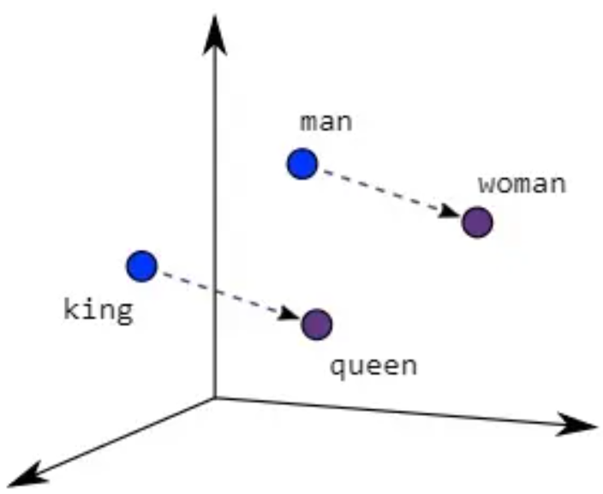
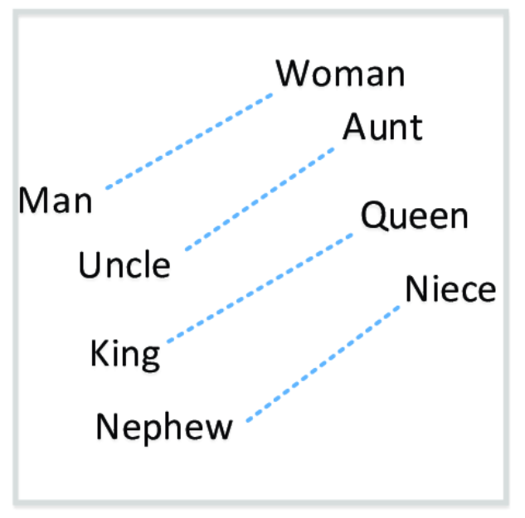
Word2Vec
Word2Vec feature
In models trained through Word2Vec, words with higher co-occurrence frequencies tend to be closer in the vector space. This means that in Euclidean distance, the vectors of semantically similar or related words (such as synonyms and antonyms) will approach each other.
Vector operations reveal semantic relationships: Vector addition and subtraction operations in the model can reveal semantic relationships between words. For example, through this vector operation, interesting semantic associations can be discovered, such as "king" subtracting "man" and adding "woman" may approach the vector of "queen".
Notes:
在通过Word2Vec训练的模型中，共现频率高的词在向量空间中会更接近。这意味着在欧几里得距离上，语义上相近或相关的词（如同义词、反义词）的向量会彼此靠近。
向量运算揭示“语义关系“：模型中的向量加法和减法运算能揭示单词间的语义关系。例如，通过这种向量运算，可以发现一些有趣的语义关联，如“国王”减去“男人”加上“女人”可能会接近“女王”的向量。

Slide 38
Word2Vec
Dimensions of Word2Vec
The Word2Vec model typically generates vectors with dimensions between 100-1000, which is significantly reduced compared to previously introduced word bag models or TF-IDF word embedding models. Moreover, these Word2Vec generated vectors can capture rich semantic information,
Dimensionality reduction: Sometimes we still need to utilize smaller dimensional vectors when resources are limited or dealing with large-scale data. To obtain smaller dimensional vectors, dimensionality reduction techniques such as principal component analysis (PCA) or t-SNE can be used. These techniques can reduce the dimensionality of vectors while preserving key information in the original vector as much as possible. The reduced vector can still reflect the semantic relationships between words, but it only uses lower computational costs.
Notes:
Word2Vec的维度
Word2Vec模型通常生成的是向量维度在100-1000维之间，相比于之前介绍的词袋模型或者TF-IDF等词嵌入模型，已经大大减少，并且这些Word2Vec产生的向量能够捕捉丰富的语义信息，
降维：我们有时仍然需要在资源受限或处理大规模数据时，利用更小维度的向量。为了获得较小维度的向量，可以采用如主成分分析（PCA）或t-SNE这样的降维技术。这些技术能够减少向量的维度，同时尽量保留原始向量中的关键信息。降维后的向量仍然能够反映词之间的语义关系，但只用到了更低的计算成本。

Slide 39
Word2Vec
The advantages and disadvantages of Word2Vec
Advantages: Word2Vec is publicly available and free of charge, often used as a pre trained word vector, and can be directly used for various natural language processing tasks without further training.
Disadvantage: Due to the fact that Word2Vec only considers contextual content during training, and our input during use is individual words, we cannot capture the relevant meanings and language structures generated by word order in the text.
Notes:
Word2Vec的优缺点
优点：Word2Vec是公开并且免费可用的，经常被用作预训练的词向量，它不需要进一步训练就可以直接用于各种自然语言处理任务。
缺点：由于Word2Vec训练时只考虑了上下文的内容，并且在使用时我们的输入都是一个个单独的词语，所以我们不能捕捉到文本中“语序”产生的相关意义与语言结构。

Slide 40
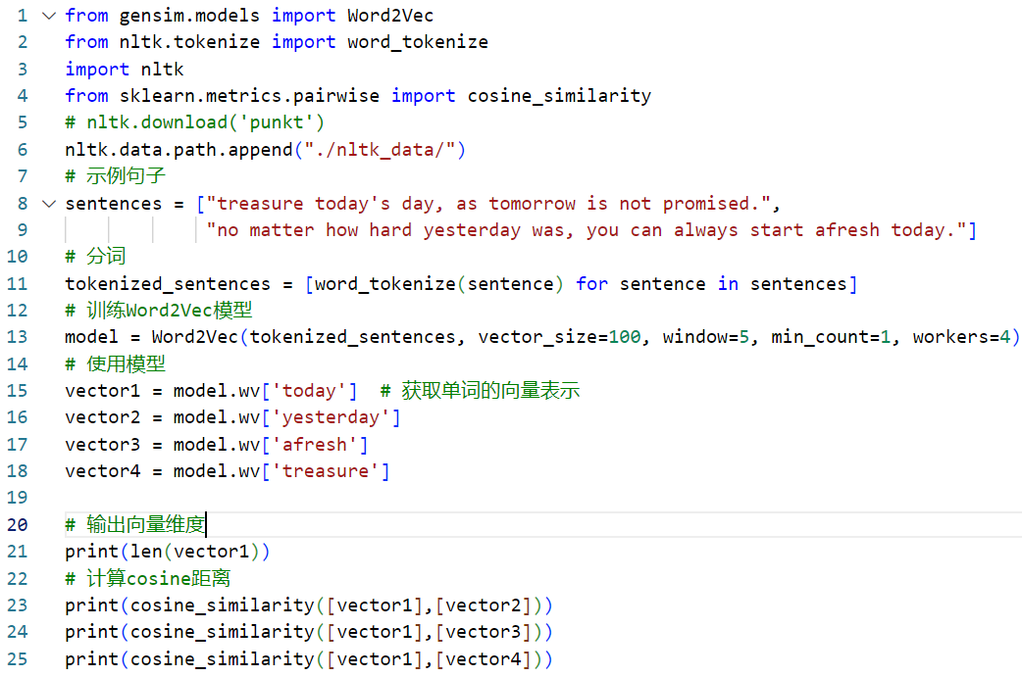
EXample：Word2Vec
Using gensim for word2vec，install: pip install -i https://pypi.tuna.tsinghua.edu.cn/simple gensim
output: ?

Slide 41
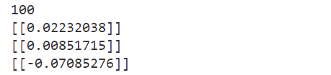
Example：Word2Vec
Using genism library for word2vec，install method: pip install -i https://pypi.tuna.tsinghua.edu.cn/simple gensim
output:

Slide 42
GloVe
GloVe (Global Vectors for Word Representation) is a word vector generation method based on word co-occurrence matrix. It combines traditional matrix factorization techniques and changes the context window method used in Word2Vec to build a global word co-occurrence matrix. Unlike Word2Vec, which mainly focuses on local contextual relationships, GloVe aims to generate a global word vector representation that captures their semantic relationships by statistically analyzing the co-occurrence information of words in the entire dataset.
The dimensions of GloVe:
The GloVe model and Word2Vec generate vector dimension types, typically such as 100, 200, or more, which also help solve the dimension problem of traditional word embeddings we mentioned earlier.
Notes:
GloVe（Global Vectors for Word Representation）是一种基于词共现矩阵的词向量生成方法。它结合了传统的矩阵分解技术并且将Word2Vec中使用的上下文窗口方法更改为搭建全局词共现矩阵。不同于Word2Vec主要聚焦于局部的上下文关系，GloVe的目标是生成一种全局的词向量表示，通过统计整个数据集中单词的共现信息来捕捉它们的语义关系。
GloVe的维度：
GloVe模型和Word2Vec产生的向量维度类型，通常如100维、200维或更多，同样帮助解决了我们之前提到的传统词嵌入的维度问题。

Slide 43
GloVe
For example, when analyzing the sentence "Light jazz sounded in the cafe":
Assuming we choose a context window size of 2, for the word "jazz", Word2Vec pays attention to its adjacent vocabulary, namely "light" and "sound". It will understand the semantics of "jazz" based on these directly adjacent words;
However, GloVe does not only focus on the local context of vocabulary, but also considers the co-occurrence frequency of "jazz" with all other vocabulary in the entire dataset. For example, it will analyze the co-occurrence of "jazz" with words such as "cafe", "light", "sounded", etc. throughout the entire dataset. For example, if "jazz" and "cafe" frequently appear together in the dataset, GloVe recognizes a strong correlation between these two words.
When dealing with the phrase "Light jazz sounded in the cafe", Word2Vec focuses more on understanding the meaning of "jazz" in this specific context (local context). GloVe, on the other hand, is seeking to understand how "jazz" is associated with various vocabulary throughout the entire dataset (global context), in order to capture its broader semantic relationships. These two methods provide different perspectives to understand the semantics and usage of vocabulary.
Notes:
例如，在分析句子“Light jazz sounded in the cafe”时：
假设我们选择上下文窗口大小为2，对于“jazz”这个词，Word2Vec会关注它紧邻的词汇，即“light”和“sounded”。它会基于这些直接邻近的词汇来理解“jazz”的语义；
但是GloVe不是只关注词汇的局部上下文，而是考虑整个数据集中“jazz”与其他所有词汇的共现频率。例如，它会分析“jazz”在整个数据集中与“cafe”、“light”、” sounded”等词的共现情况。例如，如果“jazz”和“cafe”在数据集中经常一起出现，GloVe会识别到这两个词之间的强关联。
在处理“Light jazz sounded in the cafe”这句话时，Word2Vec更侧重于理解“jazz”在这个特定上下文（局部上下文）中的意义。而GloVe则在寻求理解“jazz”如何在整个数据集（全局上下文）中与各种词汇相关联，从而捕捉其更广泛的语义关系。这两种方法提供了不同的视角来理解词汇的语义和用法。

Slide 44
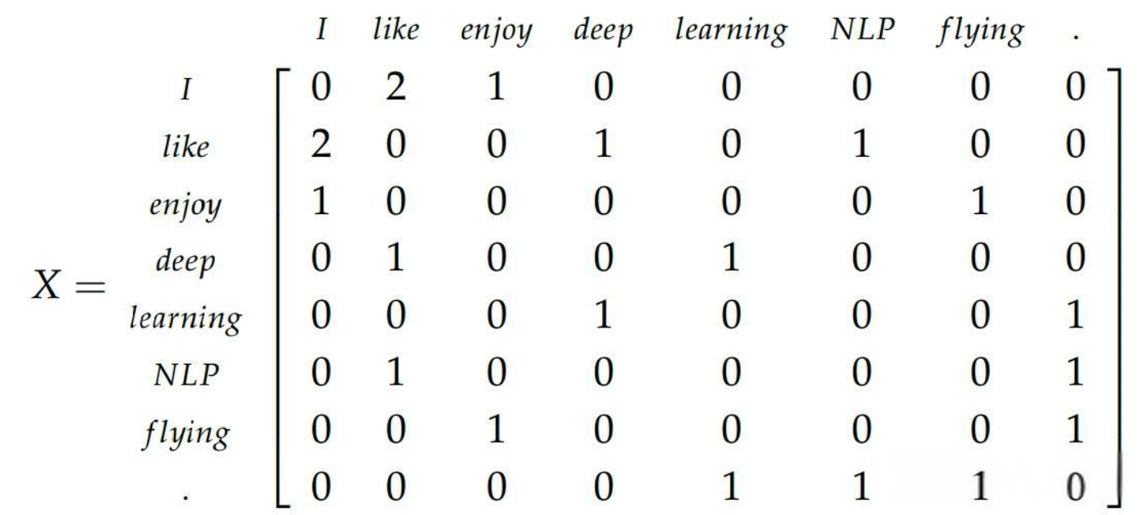
GloVe model
Model characteristics:
Based on word co-occurrence matrix: Unlike Word2Vec, which uses a fixed size "context window" to capture words around the target word. This window slides throughout the entire text, only considering the relationship between the words in the window and the target word;
GloVe constructs a huge global word co-occurrence matrix. This matrix calculates the co-occurrence frequency of each pair of words in the entire corpus, in order to capture the global word relationships.
Notes:
模型特性：
基于词共现矩阵：不同于Word2Vec使用一个固定大小的“上下文窗口”来捕捉目标词周围的词。这个窗口在整个文本中滑动，只考虑窗口内的词与目标词之间的关系；GloVe通过构建一个巨大的全局词共现矩阵。这个矩阵在整个语料库中统计每对词的共现频率，从而捕捉全局的词语关系。

Slide 45
GloVe model
Model characteristics:
From another perspective, the GloVe model can reveal the complex relationships between words, as it is based on global statistical data rather than relying solely on local context.
By analyzing the co-occurrence matrix of words, GloVe can capture deeper semantic relationships, such as identifying words that frequently appear together in different texts.
Notes:
模型特性：
从另一个角度，GloVe模型能够揭示单词之间不同的复杂关系，因为它基于全局统计数据而非仅仅依赖局部上下文。
通过分析词共现矩阵，GloVe能够捕捉到更深层次的语义关系，例如能够识别出经常在不同文本中一起出现的单词。

Slide 46
GloVe model
Other advantages and disadvantages of GloVe:
Advantages: GloVe is popular for its unique way of handling co-occurrence information, providing a different perspective from Word2Vec to understand the semantics of words. Similar to Word2Vec, the GloVe model is also open source and can be directly applied to various natural language processing tasks.
Disadvantage: Similar to Word2Vec, GloVe does not consider word order when constructing a co-occurrence matrix. Its focus is on the overall usage pattern of words, and the order of words in the statement cannot be perfectly captured.
Notes:
GloVe的其他优点与缺点：
优点：GloVe因其独特的处理词共现信息的方式而备受欢迎，提供了与Word2Vec不同的视角来理解单词的语义。与Word2Vec类似，GloVe模型也是开源的，并且可以直接应用于各种自然语言处理任务。
缺点：与Word2Vec类似，在构建词共现矩阵时，GloVe不考虑“词序问题“。它的关注点在于词语整体的使用模式，词语在语句中的排列顺序并不能被完美捕捉到。

Slide 47
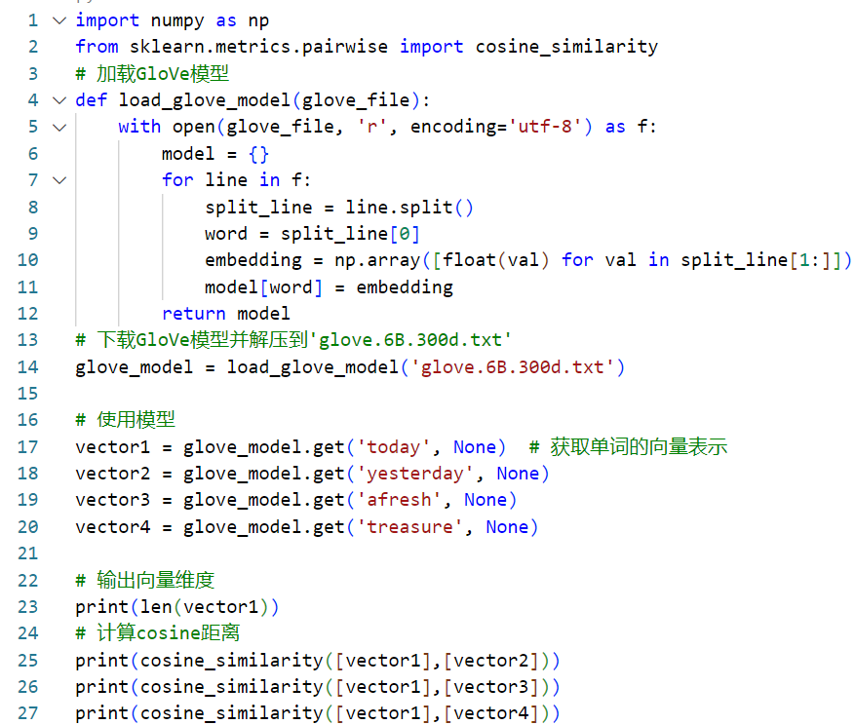
Example：GloVe
GloVe models are usually provided in pre trained form, and pre trained word vectors can be downloaded from GloVe's official website. After downloading, you can use the following code to load and use the GloVe model in Python:
输出: ?
Notes:
GloVe模型通常以预训练的形式提供，可以从GloVe的官方网站下载预训练的词向量。下载后，可以使用以下代码在Python中加载和使用GloVe模型：

Slide 48
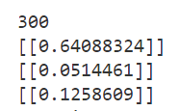
Example：GloVe
GloVe models are usually provided in pre trained form, and pre trained word vectors can be downloaded from GloVe's official website. After downloading, you can use the following code to load and use the GloVe model in Python:
output: ?
Notes:
GloVe模型通常以预训练的形式提供，可以从GloVe的官方网站下载预训练的词向量。下载后，可以使用以下代码在Python中加载和使用GloVe模型：

Slide 49

谢谢！

